Slide 1
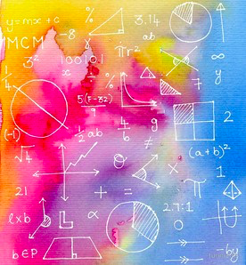
INTERPRETATION OF MAXIMA AND MINIMA IN HIGHER DIMENSIONS
One of the most important applications of calculus is its ability to find the maximum or the minimum of a function.
Explaining with an example , if we are running a company, and we've come up with some function to model how much money we can expect to make, based on a number of parameters, such as employee salaries, cost of raw materials, etc., and we want to find the right combination of resources that will maximize your revenues. In machine learning and artificial intelligence, the way a computer "learns" how to do something is commonly to minimize some "cost function" that the programmer has specified.

Slide 2
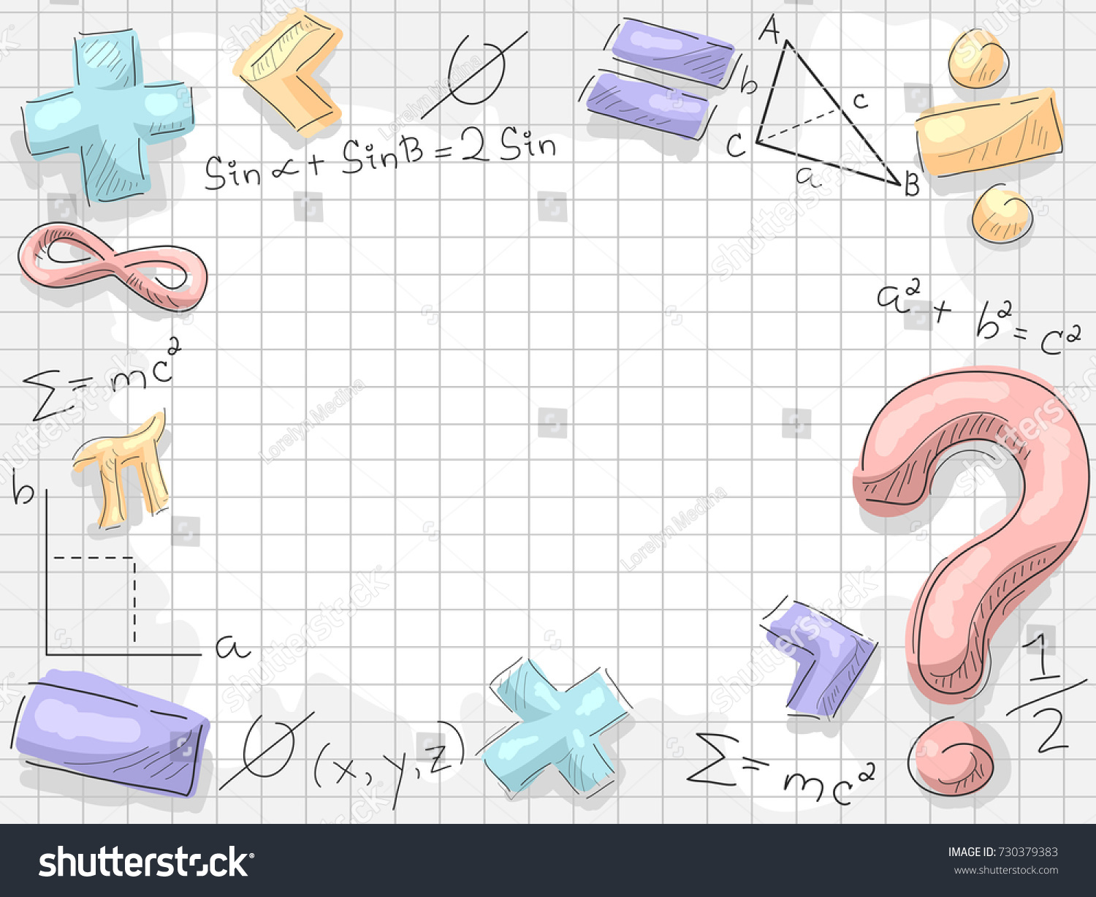
Local extreme of differentiable functions can be found by Fermat's theorem, which states that they must occur at critical points. One can distinguish whether a critical point is a local maximum or local minimum by using the first derivative test, second derivative test, or higher-order derivative test, given sufficient differentiability.
EXAMPLES
The function x³/3 − x has first derivative x² − 1 and second derivative 2x.
The function x² has a unique global minimum at x = 0.

Slide 3

Lagrange’s method of undetermined multipliers for function of two variables
The Method of Lagrange Multipliers is a strategy for finding the local maxima and minima of a function subject to equality constraints .
The great advantage of this method is that it allows the optimization to be solved without explicit parameterization in terms of the constraints. As a result, the method of Lagrange multipliers is widely used to solve challenging constrained optimization problems.
For the case of only two variables and choice of only two variables we,
maximize f(x ,y ) =0
Subject to g(x ,y) =0

Slide 4

We assume that both f and g have continuous first partial derivatives. We introduce a new variable (z) called a Lagrange multiplier and study the Lagrange function (or Lagrangian Expression) defined by
L(x ,y ,z)= f(x ,y)- z .g(x ,y)

Slide 5

APPLICATIONS OF FUNCTIONS IN PRACTICAL LIFE
A mathematical function can be expressed as f(x)=y. We say that it is a function if the value of the variable depends on the value of the other variable. In this case we are presenting x as the independent variable and y as the dependent variable.
The applications of functions are everywhere in “real life”. For Example
(i) if we consider the price of a car,
it depends on the cost of raw materials(variables) such as Metals, Plastics, Glass, Salary, Location of the company, Taxes, Quality of manufacturing, etc.
(ii) The climate of any region is a function of temperature and air pressure, density, ocean-atmosphere interaction, Carbon dioxide presence, altitude, etc.

Slide 6

(iii) The size and health of a new born baby is a function of his/her parents genetics, etc.
(iv)The total distance covered by any vehicle depends on the time spent by the vehicle.
(v)Functions are re-usable block of code in a program. It helps you keep your code DRY (Don't Repeat Yourself) compliant.

